Slide 1
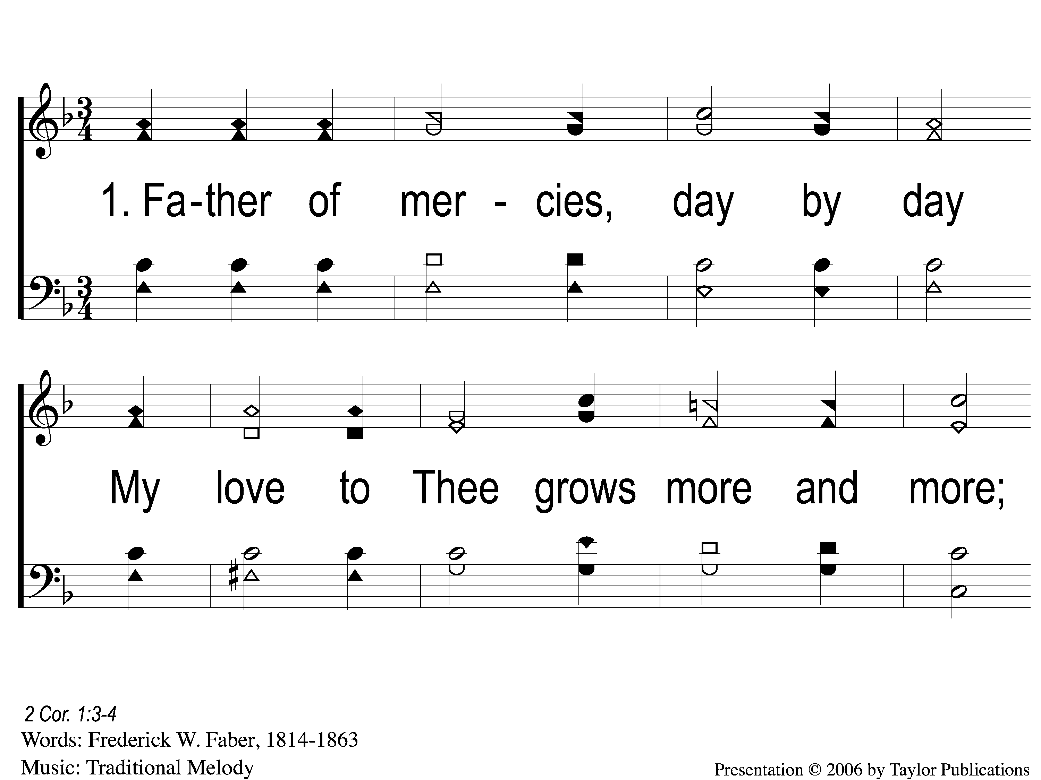
1-1 Father Of Mercies
Father Of Mercies
122

Slide 2
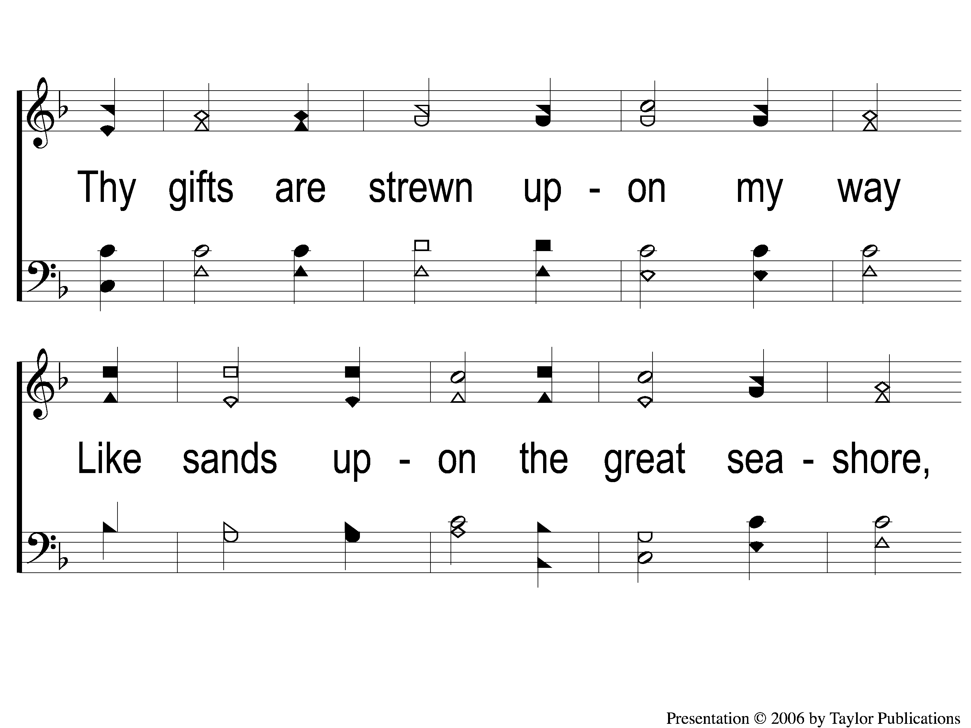
1-2 Father Of Mercies
Father Of Mercies
122

Slide 3
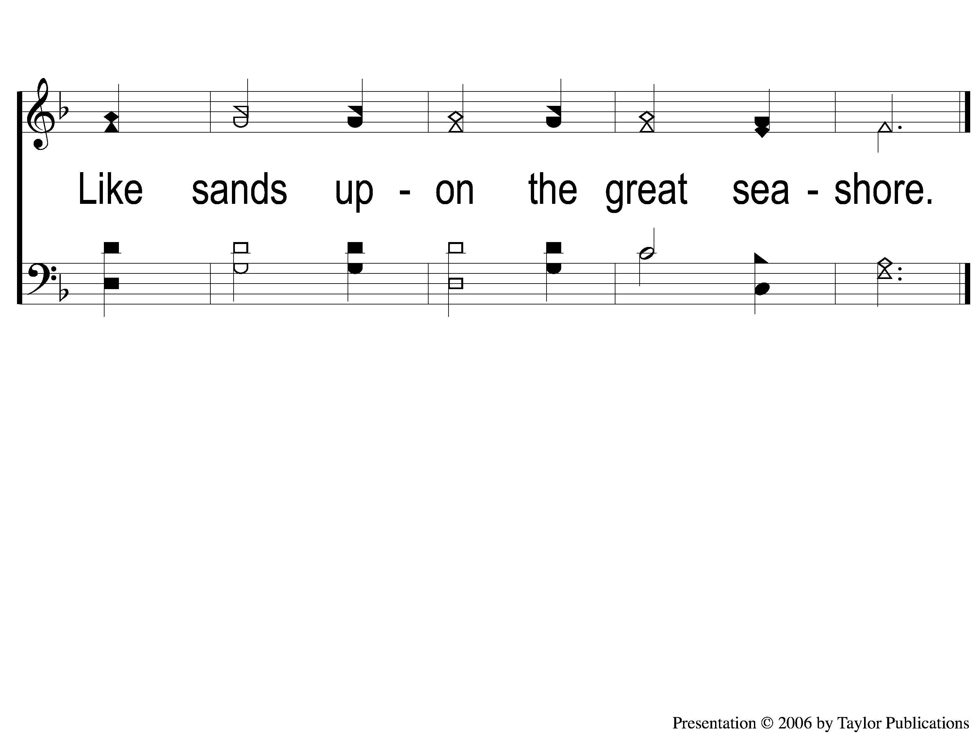
1-3 Father Of Mercies
Father Of Mercies
122

Slide 4
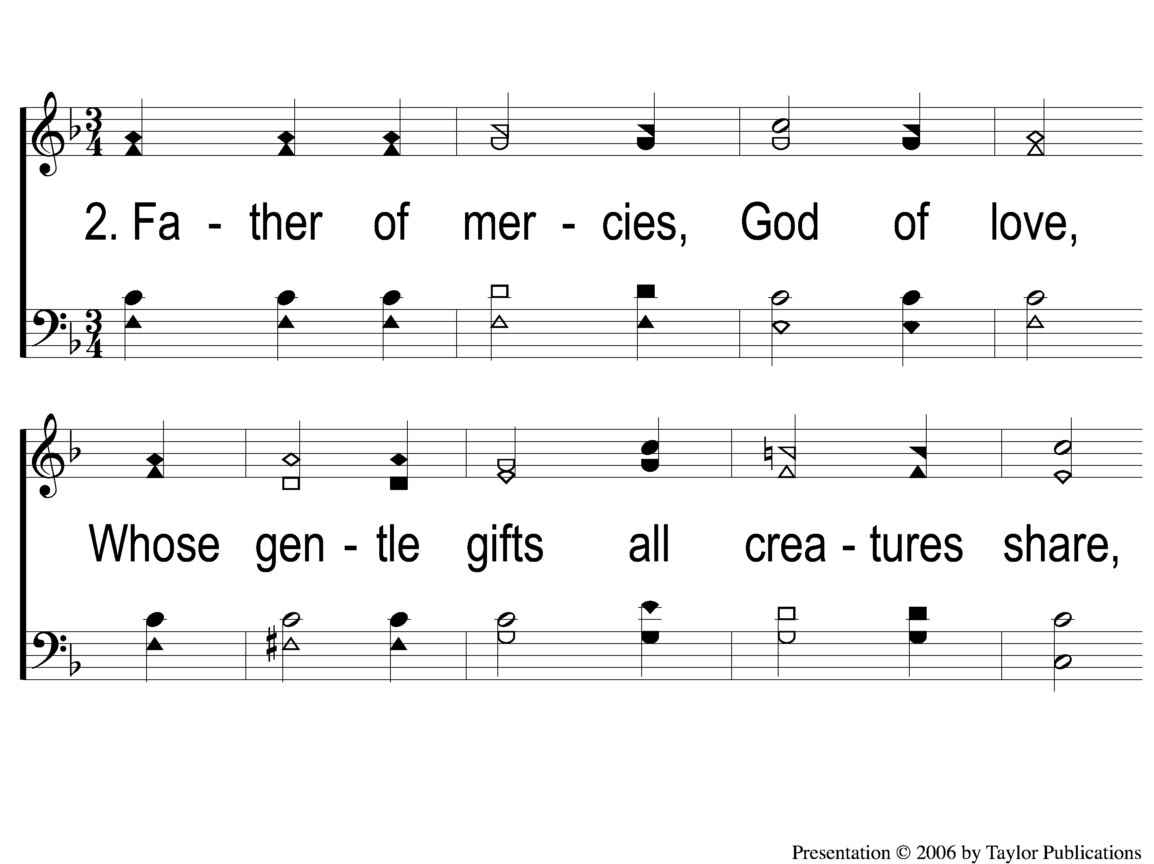
2-1 Father Of Mercies
Father Of Mercies
122

Slide 5
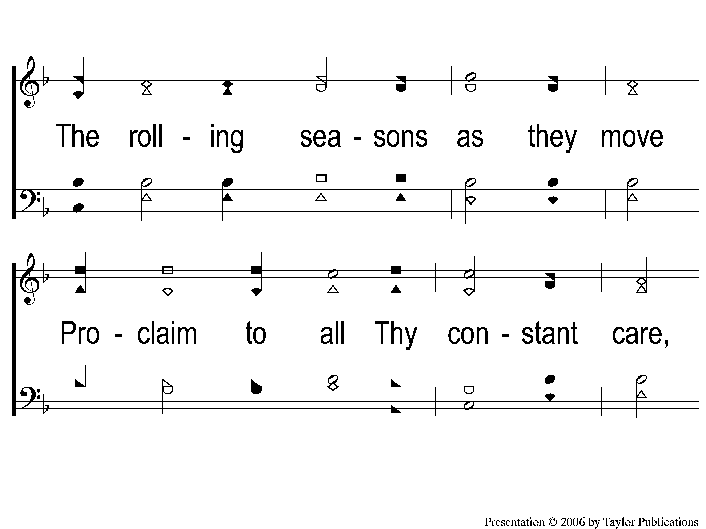
2-2 Father Of Mercies
Father Of Mercies
122

Slide 6
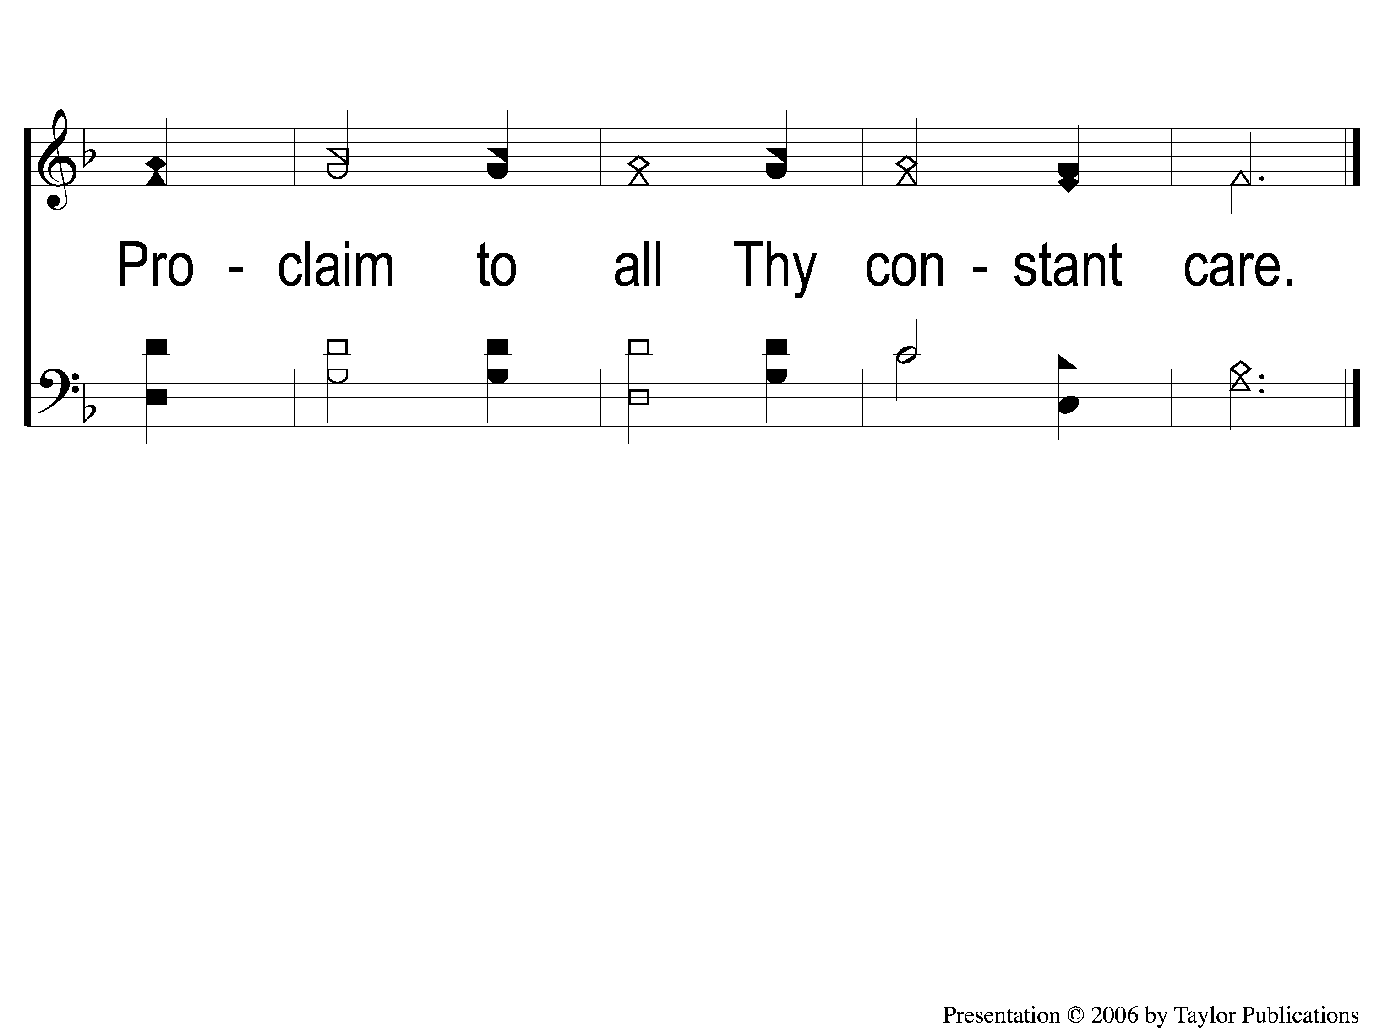
2-3 Father Of Mercies
Father Of Mercies
122

Slide 7
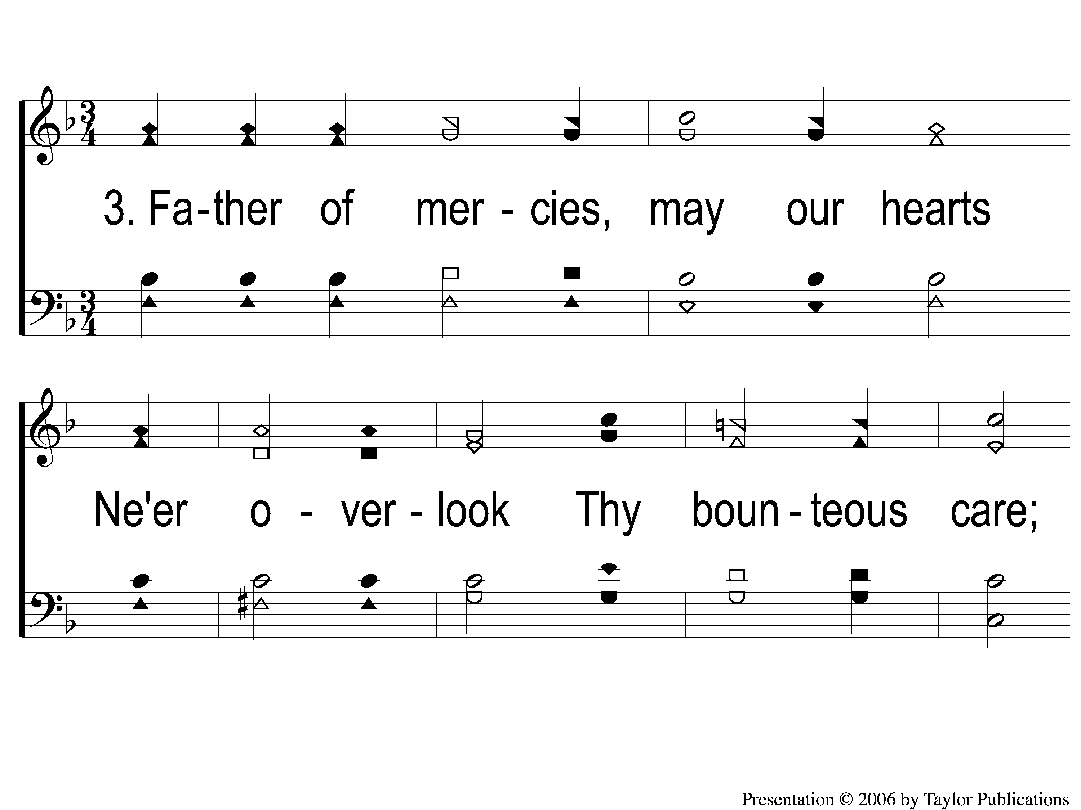
3-1 Father Of Mercies
Father Of Mercies
122

Slide 8
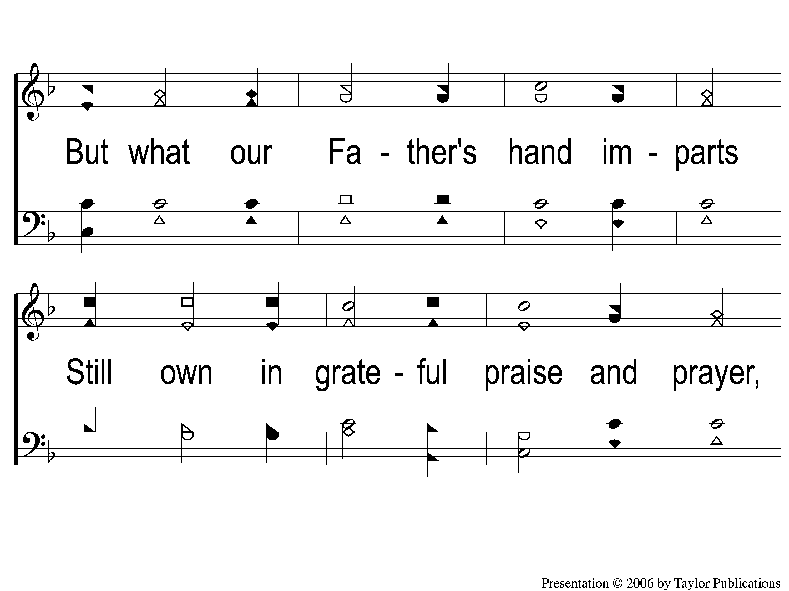
3-2 Father Of Mercies
Father Of Mercies
122

Slide 9
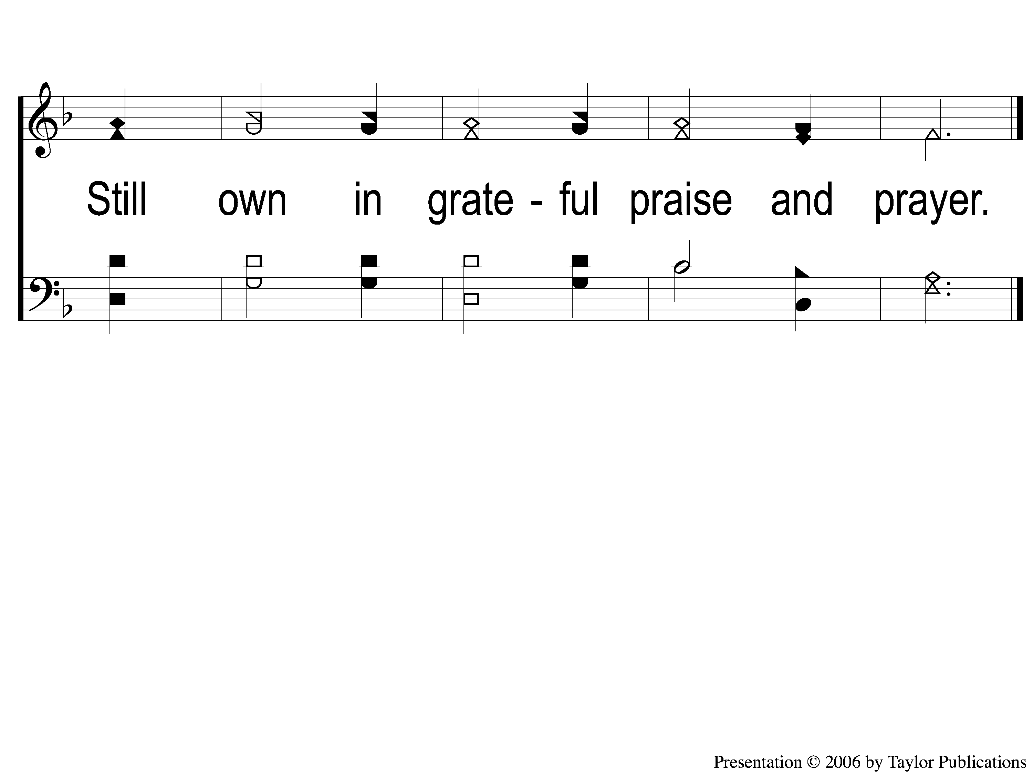
3-3 Father Of Mercies
Father Of Mercies
122

